Slide 1
Hi! This is CS50.
Today's lecture is 3pm–5pm. We'll take a short break (mini cupcakes, with GF and vegan options) partway through.
See website after lecture for Quiz 3, due tomorrow (Tue 9/24) at 10:30am.
If you have trouble seeing projector, see live.cs50.io/screen for a live feed.
See website after lecture for Problem Set 3, due Sun 9/29 at 11:59pm.
Optionally attend Brian's Supersection tonight at 7:30pm via Zoom, per website.
Optionally sign up via website for a tutorial this week!

Slide 2
This is CS50

Slide 3
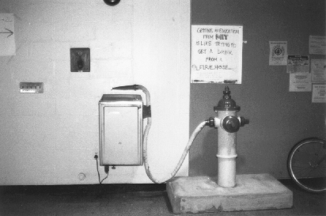
Notes:
1991
``Getting an Education from MIT is like taking a drink from a Fire Hose.'' http://hacks.mit.edu/Hacks/by_year/1991/fire_hydrant/

Slide 4
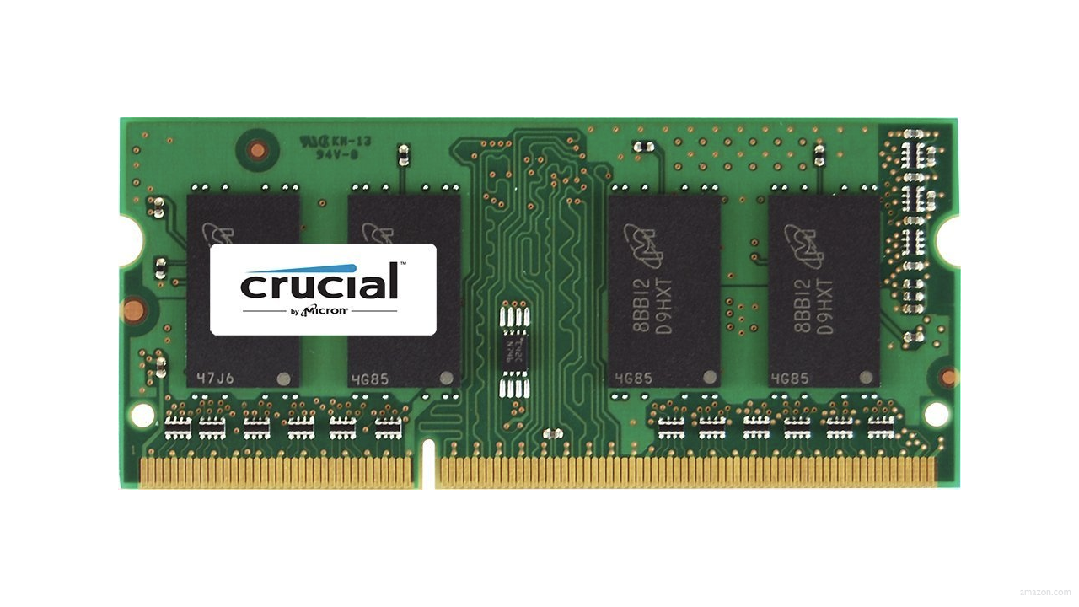

Slide 10
input →
→ output

Slide 11

→
→ output

Slide 12
→
→ bool

Slide 13
algorithms

Slide 14
linear search
Notes:
7 2 1 6 3 4 50

Slide 15
For i from 0 to n-1
If i'th element is 50
Return true
Return false

Slide 16
binary search
Notes:
3 4 6 7 50 82 91

Slide 17
If middle item is 50
Return true
Else if 50 < middle item
Search left half
Else if 50 > middle item
Search right half

Slide 18
If no items
If middle item is 50
Return true
Else if 50 < middle item
Search left half
Else if 50 > middle item
Search right half

Slide 19
If no items
Return false
If middle item is 50
Return true
Else if 50 < middle item
Search left half
Else if 50 > middle item
Search right half

Slide 20
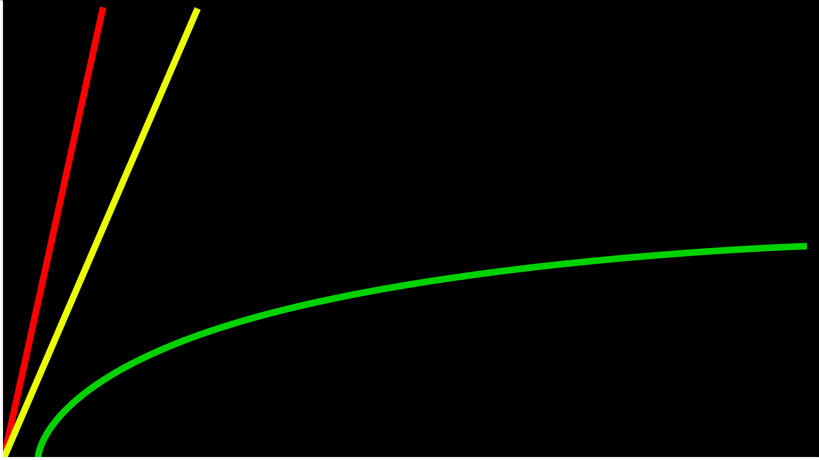
time to solve
size of problem

Slide 21
O(n)
O(n/2)
time to solve
O(log₂n)
size of problem

Slide 22
O

Slide 23
O(n)
O(n/2)
time to solve
O(log₂n)
size of problem

Slide 24
O(n)
O(n/2)
time to solve
O(log₂n)
size of problem

Slide 25
O(n)
O(n)
time to solve
O(log₂n)
size of problem

Slide 26
O(n)
O(n)
time to solve
O(log n)
size of problem

Slide 27
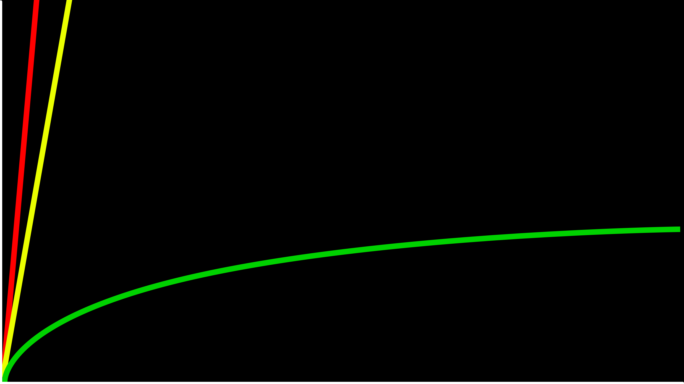
O(n)
time to solve
O(log n)
size of problem

Slide 28
O(n²)
O(n log n)
O(n)
O(log n)
O(1)

Slide 29
O(n²)
O(n log n)
O(n) linear search
O(log n)
O(1)

Slide 30
O(n²)
O(n log n)
O(n) linear search
O(log n) binary search
O(1)

Slide 31
Ω

Slide 32
Ω(n²)
Ω(n log n)
Ω(n)
Ω(log n)
Ω(1)

Slide 33
Ω(n²)
Ω(n log n)
Ω(n)
Ω(log n)
Ω(1) linear search

Slide 34
Ω(n²)
Ω(n log n)
Ω(n)
Ω(log n)
Ω(1) linear search, binary search

Slide 35
int numbers[]
Notes:
numbers.c

Slide 36
string names[]
Notes:
numbers.c

Slide 37
person people[]
Notes:
phonebook*.c

Slide 38
string name;
string number;

Slide 39
typedef struct
{
string name;
string number;
}
person;

Slide 40
input →
→ output

Slide 41
unsorted →
→ output

Slide 42
unsorted →
→ sorted

Slide 43
→
→ sorted
7 2 1 6 3 4 50

Slide 44
→
→
7 2 1 6 3 4 50
1 2 3 4 6 7 50

Slide 45
6 3 8 5 2 7 4 1

Slide 46
bubble sort
Notes:
6 3 8 5 2 7 4 1

Slide 47
Repeat n-1 times
For i from 0 to n-2
If i'th and i+1'th elements out of order
Swap them

Slide 48
O

Slide 49
Repeat n-1 times
For i from 0 to n-2
If i'th and i+1'th elements out of order
Swap them

Slide 50
(n – 1) × (n – 1)

Slide 51
(n – 1) × (n – 1)
n² – 1n – 1n + 1

Slide 52
(n – 1) × (n – 1)
n² – 1n – 1n + 1
n² – 2n + 1

Slide 53
(n – 1) × (n – 1)
n² – 1n – 1n + 1
n² – 2n + 1
O(n²)

Slide 54
O(n²)
O(n log n)
O(n) linear search
O(log n) binary search
O(1)

Slide 55
O(n²) bubble sort
O(n log n)
O(n) linear search
O(log n) binary search
O(1)

Slide 56
Ω

Slide 57
Repeat n-1 times For i from 0 to n-2 If i'th and i+1'th elements out of order Swap them

Slide 58
Ω(n²)
Ω(n log n)
Ω(n)
Ω(log n)
Ω(1) linear search, binary search

Slide 59
Ω(n²) bubble sort
Ω(n log n)
Ω(n)
Ω(log n)
Ω(1) linear search, binary search

Slide 60
selection sort
Notes:
6 8 5 3 2 7 4 1

Slide 61
6 3 8 5 2 7 4 1

Slide 62
For i from 0 to n-1
Find smallest item between i'th item and last item
Swap smallest item with i'th item

Slide 63
O

Slide 64
For i from 0 to n-1
Find smallest item between i'th item and last item
Swap smallest item with i'th item

Slide 66
n

Slide 67
n + (n – 1)

Slide 68
n + (n – 1) + (n – 2)

Slide 69
n + (n – 1) + (n – 2) + ... + 1

Slide 70
n + (n – 1) + (n – 2) + ... + 1
n(n + 1)/2

Slide 71
n + (n – 1) + (n – 2) + ... + 1
n(n + 1)/2
(n² + n)/2

Slide 72
n + (n – 1) + (n – 2) + ... + 1
n(n + 1)/2
(n² + n)/2
n²/2 + n/2

Slide 73
n + (n – 1) + (n – 2) + ... + 1
n(n + 1)/2
(n² + n)/2
n²/2 + n/2
O(n²)

Slide 74
O(n²) bubble sort
O(n log n)
O(n) linear search
O(log n) binary search
O(1)

Slide 75
O(n²) bubble sort, selection sort
O(n log n)
O(n) linear search
O(log n) binary search
O(1)

Slide 76
Ω

Slide 77
For i from 0 to n-1
Find smallest item between i'th item and last item
Swap smallest item with i'th item

Slide 78
Ω(n²) bubble sort
Ω(n log n)
Ω(n)
Ω(log n)
Ω(1) linear search, binary search

Slide 79
Ω(n²) bubble sort, selection sort
Ω(n log n)
Ω(n)
Ω(log n)
Ω(1) linear search, binary search

Slide 80
bubble sort

Slide 81
Repeat n-1 times For i from 0 to n-2 If i'th and i+1'th elements out of order Swap them

Slide 82
Repeat until no swaps For i from 0 to n-2 If i'th and i+1'th elements out of order Swap them

Slide 83
Ω(n²) bubble sort, selection sort
Ω(n log n)
Ω(n)
Ω(log n)
Ω(1) linear search, binary search

Slide 84
Ω(n²) selection sort
Ω(n log n)
Ω(n) bubble sort
Ω(log n)
Ω(1) linear search, binary search

Slide 85
elections

Slide 86
recursion

Slide 87
1 Pick up phone book
2 Open to middle of phone book
3 Look at page
4 If Smith is on page
5 Call Mike
6 Else if Smith is earlier in book
7 Open to middle of left half of book
8 Go back to line 3
9 Else if Smith is later in book
10 Open to middle of right half of book
11 Go back to line 3
12 Else
13 Quit

Slide 88
1 Pick up phone book
2 Open to middle of phone book
3 Look at page
4 If Smith is on page
5 Call Mike
6 Else if Smith is earlier in book
7 Open to middle of left half of book
8 Go back to line 3
9 Else if Smith is later in book
10 Open to middle of right half of book
11 Go back to line 3
12 Else
13 Quit

Slide 89
1 Pick up phone book
2 Open to middle of phone book
3 Look at page
4 If Smith is on page
5 Call Mike
6 Else if Smith is earlier in book
7 Open to middle of left half of book
8
9 Else if Smith is later in book
10 Open to middle of right half of book
11
12 Else
13 Quit

Slide 90
1 Pick up phone book
2 Open to middle of phone book
3 Look at page
4 If Smith is on page
5 Call Mike
6 Else if Smith is earlier in book
7 Search left half of book
8
9 Else if Smith is later in book
10 Search right half of book
11
12 Else
13 Quit

Slide 91
1 Pick up phone book
2 Open to middle of phone book
3 Look at page
4 If Smith is on page
5 Call Mike
6 Else if Smith is earlier in book
7 Search left half of book
8
9 Else if Smith is later in book
10 Search right half of book
11
12 Else
13 Quit

Slide 92
1 Pick up phone book
2 Open to middle of phone book
3 Look at page
4 If Smith is on page
5 Call Mike
6 Else if Smith is earlier in book
7 Search left half of book
8 Else if Smith is later in book
9 Search right half of book
10 Else
11 Quit

Slide 93

Notes:
http://ian-albert.com/games/super_mario_bros_maps/

Slide 94


Slide 95


Slide 96


Slide 97


Slide 98


Slide 99
merge sort

Slide 100
If only one item
Return
Else
Sort left half of items
Sort right half of items
Merge sorted halves

Slide 101
If only one item
Return
Else
Sort left half of items
Sort right half of items
Merge sorted halves

Slide 102
Notes:
1991
``Getting an Education from MIT is like taking a drink from a Fire Hose.'' http://hacks.mit.edu/Hacks/by_year/1991/fire_hydrant/

Slide 103
7 | 4 | 5 | 2 | 6 | 3 | 8 | 1

Slide 104
7 | 4 | 5 | 2 | 6 | 3 | 8 | 1

Slide 105
7 | 4 | 5 | 2 | 6 | 3 | 8 | 1

Slide 106
7 | 4 | 5 | 2 | 6 | 3 | 8 | 1

Slide 107
7 | 4 | 5 | 2 | 6 | 3 | 8 | 1

Slide 108
7 | 4 | 5 | 2 | 6 | 3 | 8 | 1

Slide 109
7 |  | 5 | 2 | 6 | 3 | 8 | 1
4

Slide 110
 |  | 5 | 2 | 6 | 3 | 8 | 1
4 | 7

Slide 111
 |  | 5 | 2 | 6 | 3 | 8 | 1
4 | 7

Slide 112
 |  | 5 | 2 | 6 | 3 | 8 | 1
4 | 7

Slide 113
 |  | 5 | 2 | 6 | 3 | 8 | 1
4 | 7

Slide 114
 |  | 5 | 2 | 6 | 3 | 8 | 1
4 | 7

Slide 115
 |  | 5 |  | 6 | 3 | 8 | 1
4 | 7 | 2

Slide 116
 |  |  |  | 6 | 3 | 8 | 1
4 | 7 | 2 | 5

Slide 117
 |  |  |  | 6 | 3 | 8 | 1
4 | 7 | 2 | 5

Slide 118
 |  |  |  | 6 | 3 | 8 | 1
4 | 7 |  | 5
2

Slide 119
 |  |  |  | 6 | 3 | 8 | 1
 | 7 |  | 5
2 | 4

Slide 120
 |  |  |  | 6 | 3 | 8 | 1
 | 7
2 | 4 | 5

Slide 121
 |  |  |  | 6 | 3 | 8 | 1
2 | 4 | 5 | 7

Slide 122
 |  |  |  | 6 | 3 | 8 | 1
2 | 4 | 5 | 7

Slide 123
 |  |  |  | 6 | 3 | 8 | 1
2 | 4 | 5 | 7

Slide 124
 |  |  |  | 6 | 3 | 8 | 1
2 | 4 | 5 | 7

Slide 125
 |  |  |  | 6 | 3 | 8 | 1
2 | 4 | 5 | 7

Slide 126
 |  |  |  | 6 | 3 | 8 | 1
2 | 4 | 5 | 7

Slide 127
 |  |  |  | 6 |  | 8 | 1
 |  |  |  | 3
2 | 4 | 5 | 7

Slide 128
 |  |  |  |  |  | 8 | 1
 |  |  |  | 3 | 6
2 | 4 | 5 | 7

Slide 129
 |  |  |  |  |  | 8 | 1
 |  |  |  | 3 | 6
2 | 4 | 5 | 7

Slide 130
 |  |  |  |  |  | 8 | 1
 |  |  |  | 3 | 6
2 | 4 | 5 | 7

Slide 131
 |  |  |  |  |  | 8 | 1
 |  |  |  | 3 | 6
2 | 4 | 5 | 7

Slide 132
 |  |  |  |  |  | 8 | 1
 |  |  |  | 3 | 6
2 | 4 | 5 | 7

Slide 133
 |  |  |  |  |  | 8 | 1
 |  |  |  | 3 | 6 | 1
2 | 4 | 5 | 7

Slide 134
 |  |  |  |  |  |  | 1
 |  |  |  | 3 | 6 | 1 | 8
2 | 4 | 5 | 7

Slide 135
 |  |  |  |  |  |  | 1
 |  |  |  | 3 | 6 | 1 | 8
2 | 4 | 5 | 7

Slide 136
 |  |  |  |  |  |  | 1
 |  |  |  | 3 | 6 |  | 8
2 | 4 | 5 | 7 | 1

Slide 137
 |  |  |  |  |  |  | 1
 |  |  |  |  | 6 |  | 8
2 | 4 | 5 | 7 | 1 | 3

Slide 138
 |  |  |  |  |  |  | 1
 |  |  |  |  |  |  | 8
2 | 4 | 5 | 7 | 1 | 3 | 6

Slide 139
 |  |  |  |  |  |  | 1
 |  |  |  |  |  |  | 8
2 | 4 | 5 | 7 | 1 | 3 | 6 | 8

Slide 140
 |  |  |  |  |  |  | 1
 |  |  |  |  |  |  | 8
2 | 4 | 5 | 7 | 1 | 3 | 6 | 8

Slide 141
 |  |  |  |  |  |  | 1
 |  |  |  |  |  |  | 8
2 | 4 | 5 | 7 |  | 3 | 6 | 8
1

Slide 142
 |  |  |  |  |  |  | 1
 |  |  |  |  |  |  | 8
 | 4 | 5 | 7 |  | 3 | 6 | 8
1 | 2

Slide 143
 |  |  |  |  |  |  | 1
 |  |  |  |  |  |  | 8
 | 4 | 5 | 7 |  |  | 6 | 8
1 | 2 | 3

Slide 144
 |  |  |  |  |  |  | 1
 |  |  |  |  |  |  | 8
 |  | 5 | 7 |  |  | 6 | 8
1 | 2 | 3 | 4

Slide 145
 |  |  |  |  |  |  | 1
 |  |  |  |  |  |  | 8
 |  |  | 7 |  |  | 6 | 8
1 | 2 | 3 | 4 | 5

Slide 146
 |  |  |  |  |  |  | 1
 |  |  |  |  |  |  | 8
 |  |  | 7 |  |  |  | 8
1 | 2 | 3 | 4 | 5 | 6

Slide 147
 |  |  |  |  |  |  | 1
 |  |  |  |  |  |  | 8
 |  |  |  |  |  |  | 8
1 | 2 | 3 | 4 | 5 | 6 | 7

Slide 148
 |  |  |  |  |  |  | 1
 |  |  |  |  |  |  | 8
1 | 2 | 3 | 4 | 5 | 6 | 7 | 8

Slide 150
 |  |  |  |  |  |  | 1
7 | 4 | 5 | 2 | 6 | 3 | 8 | 1

Slide 151
 |  |  |  |  |  |  | 1
7 | 4 | 5 | 2 | 6 | 3 | 8 | 1
 |  |  |  |  |  |  | 8
4 | 7 | 2 | 5 | 3 | 6 | 1 | 8

Slide 152
 |  |  |  |  |  |  | 1
7 | 4 | 5 | 2 | 6 | 3 | 8 | 1
 |  |  |  |  |  |  | 8
4 | 7 | 2 | 5 | 3 | 6 | 1 | 8
2 | 4 | 5 | 7 | 1 | 3 | 6 | 8

Slide 153
 |  |  |  |  |  |  | 1
7 | 4 | 5 | 2 | 6 | 3 | 8 | 1
 |  |  |  |  |  |  | 8
4 | 7 | 2 | 5 | 3 | 6 | 1 | 8
2 | 4 | 5 | 7 | 1 | 3 | 6 | 8
1 | 2 | 3 | 4 | 5 | 6 | 7 | 8

Slide 154
O(n²) bubble sort, selection sort
O(n log n)
O(n) linear search
O(log n) binary search
O(1)

Slide 155
O(n²) bubble sort, selection sort
O(n log n) merge sort
O(n) linear search
O(log n) binary search
O(1)

Slide 156
Ω(n²) selection sort
Ω(n log n)
Ω(n) bubble sort
Ω(log n)
Ω(1) linear search, binary search

Slide 157
Ω(n²) selection sort
Ω(n log n) merge sort
Ω(n) bubble sort
Ω(log n)
Ω(1) linear search, binary search

Slide 158
Θ

Slide 159
Θ(n²)
Θ(n log n)
Θ(n)
Θ(log n)
Θ(1)

Slide 160
Θ(n²) selection sort
Θ(n log n) merge sort
Θ(n)
Θ(log n)
Θ(1)

Slide 161
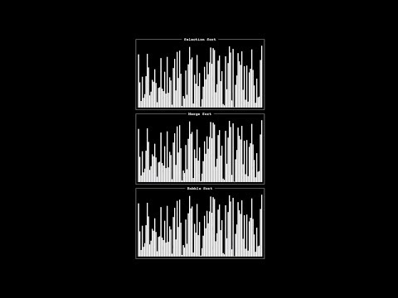
Notes:
https://www.youtube.com/watch?v=ZZuD6iUe3Pc

Slide 162
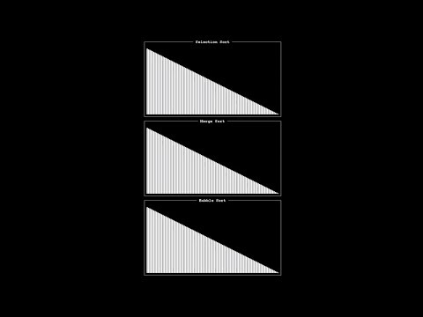
Notes:
https://www.youtube.com/watch?v=ZZuD6iUe3Pc

Slide 163
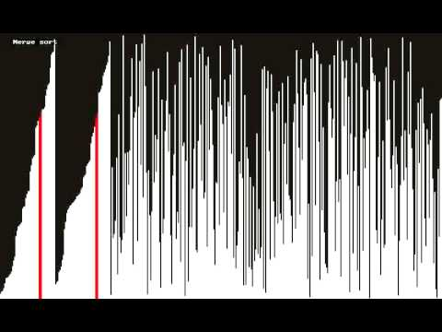
Notes:
https://www.youtube.com/watch?v=t8g-iYGHpEA

Slide 164
This is CS50

